Slide 1
PSCS218- A cross-platform mobile application to display the important features of Yamaha bikes (Yamaha RideRealm)
PIP2001 Capstone Project
Review-1
Batch Number: CBC-03
Under the Supervision of,
Mr. Ramamurthy Ketha
Assistant Professor
School of Computer Science and Engineering
Presidency University
Roll Number | Student Name
20211CBC0006 20211CBC0029 20211CBC0048 20221LBC0003 | GOVIND CHAUDHARY YASH SINGH AMITH GOWDA M SHOAIB ABDULLA KHAJI
Name of the Program: Bachelor of Technology
Name of the HoD: Dr. S. Pravinth Raja
Name of the Program Project Coordinator: Mr. Ramamurthy Ketha
Name of the School Project Coordinators: Dr. Abdul Khadar A

Slide 2
Introduction
Augmented Reality (AR) integrates digital content with the physical world.
The project focuses on leveraging AR technology for Yamaha Motor Pvt Ltd.
Enables customers to visualize Yamaha bikes through a cross-platform mobile app.
Combines Vuforia for QR code recognition and Google ARCore for real-time 3D object placement.
Built with Kotlin, featuring WebView for accessing Yamaha's website.
Provides an immersive experience, enhancing user engagement and reducing reliance on physical showrooms.

Slide 3
Literature Review
Augmented Reality (AR) has emerged as a transformative technology, bridging the gap between physical and digital experiences. Azuma (1997) defines AR as an interface that enhances the real world with digital content, offering interactivity in real-time. This technology has found applications in various industries, including automotive, where it aids customer engagement by providing immersive experiences. Studies highlight the role of AR in enhancing customer satisfaction by enabling virtual product exploration, which reduces the need for physical infrastructure (Huang & Liao, 2015).
The use of Vuforia for QR code recognition and Google ARCore for 3D object placement has been widely acknowledged for creating seamless AR experiences. Vuforia's precision in marker-based tracking and ARCore's capabilities in environment mapping enable accurate visualization of virtual objects in real-world scenarios (Billinghurst et al., 2015).

Slide 4
Literature Review
Mobile application development using Kotlin is gaining traction due to its modern syntax and compatibility with Android platforms. Integrating WebView into AR applications further extends user access to online resources, enhancing the user journey.
By combining AR, mobile app development, and digital marketing strategies, this project aligns with current research on innovative customer-centric solutions. It leverages AR to empower users with interactive virtual experiences, facilitating informed purchasing decisions in the automotive industry.

Slide 5
Research Gaps Identified
Limited Integration of AR in Automotive: AR's potential in virtual product visualization for the automotive sector is underexplored.
Cross-Platform Compatibility: Many AR applications lack cross-platform functionality, restricting accessibility.
Real-Time Interaction: Challenges remain in ensuring accurate real-time 3D object placement in dynamic environments.
Customer Behavior Insights: The impact of AR experiences on customer purchasing decisions is insufficiently studied.
Scalability Issues: AR solutions often fail to scale effectively for large product catalogs or diverse settings.
Digital Marketing Integration: Research is limited on AR's role in enhancing digital marketing strategies for the automotive industry.
User Experience Optimization: AR interfaces lack sufficient optimization for non-tech-savvy users exploring complex products.

Slide 6
Proposed Methodology
QR Code Integration: Utilize QR codes to trigger the AR experience when scanned by the user's device.
Markerless AR with Unity: Enable users to place bike models in their environment using Unity’s AR Foundation, integrating ARCore and ARKit.
3D Model Rendering in Unity: Import high-quality 3D models of Yamaha bikes into Unity for realistic visualization.
User Interface Design in Unity: Create an intuitive user interface for interacting with bike models, allowing rotation and scaling.
WebView Integration: Incorporate a WebView to redirect users to Yamaha’s official website for detailed product information.
User Feedback Mechanism: Include options for users to provide feedback on their AR experience within the app.

Slide 7
Objectives
Cross-Platform Development: Create a cross-platform mobile app using Vuforia and Unity for both iOS and Android.
Augmented Reality Experience: Implement an AR experience for users to scan Yamaha bikes and view interactive 3D models.
Interactive 3D Models: Offer detailed 3D models of Yamaha bike features like the engine, headlights, and suspension.
Feature Information Display: Include overlays that show specifications and descriptions of bike features during interactions.
User Interaction Enhancements: Enable intuitive interactions for users to rotate, zoom, and explore 3D models from various angles.

Slide 8
System Design and Implementation
System Architecture
QR Code Integration
Markerless AR Implementation
3D Model Rendering
User Interface (UI) Design
WebView Integration
User Feedback Mechanism
Testing and Deployment
Maintenance and Updates

Slide 9
Timeline of Project
Task | Duration
Project Planning and Requirements | 1 Week
Technology Stack Setup (Vuforia, Unity, iOS/Android) | 1 Week
3D Model Creation using Vuforia Object Scanner | 3 Weeks
Frontend Development (Vuforia + Unity) | 2 Weeks
Backend Development (Vuforia Cloud Recognition, Google Poly API) | 2 Weeks
Feature Overlay Development (Augmented Reality) | 2 Weeks
Integration with Vuforia Object Recognition | 2 Weeks
Testing & Bug Fixing | 2 Weeks
Final Review & Updates | 1 Week
Final Presentation & Submission | 1 Week

Slide 10
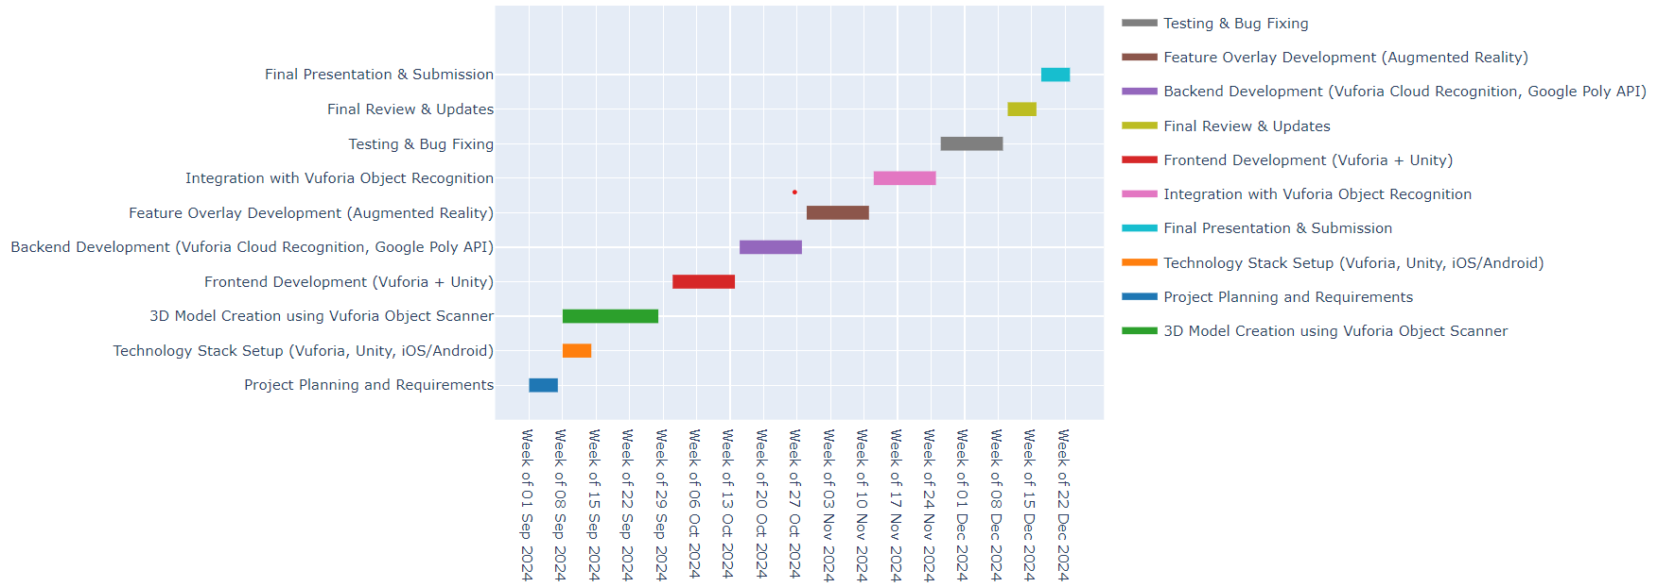
Timeline of Project

Slide 11
Outcomes
Successful implementation of an AR-based mobile application for Yamaha Motor Pvt Ltd.
Seamless integration of Vuforia for QR code recognition and ARCore for placing bike models in real-world environments.
Enhanced user interaction through a smooth transition between AR visualization and web-based detailed product reviews.
High-quality 3D model rendering: Successfully implemented high-resolution 3D bike models that provide an immersive user experience, with accurate representation of product details.
Improved user engagement: Enhanced customer engagement through gesture-based interactions and intuitive controls, allowing users to explore Yamaha bikes in-depth without needing to visit a showroom.
Cross-platform compatibility: Developed a robust cross-platform mobile application, ensuring consistent performance across both Android and iOS devices, enabling a wider user base.

Slide 12
Conclusion
Transformative Potential: This project demonstrates the impactful use of AR in revolutionizing customer interaction within the automotive industry.
Enhanced Customer Experience: By integrating ARCore and QR code technology, it enables users to visualize and interact with Yamaha bike models in their real-world environments.
Informed Decision-Making: The combination of AR visualization and web-based information empowers customers to make well-informed purchasing decisions.
Future Marketing Applications: It sets a benchmark for AR-driven marketing strategies that align with the preferences of modern consumers.
Scalability and Reference: The methodologies used provide a scalable reference for future AR-based solutions in the automotive and broader marketing sectors.

Slide 13
Github Link
Github Link
RideRealm

Slide 14
Publication Details

Slide 15
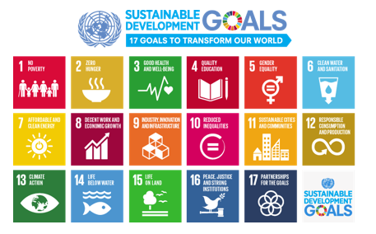
Project work mapping with SDG
This project is mapped to SDG – 8, SDG – 9, SDG – 11, SDG - 12

Slide 16
References
[1]. Linowes, J., & Babilinski, K. (2017). Augmented reality for developers: Build practical
augmented reality applications with unity, ARCore, ARKit, and Vuforia. Packt Publishing
Ltd.
Available at: https://www.scirp.org/reference/referencespapers?referenceid=3404098
[2]. Urbas, U., & Vukašinović, N. (2019). Displaying product manufacturing information in
augmented reality for inspection. Procedia CIRP, 81, 832-837.
Available at: https://www.sciencedirect.com/science/article/pii/S221282711930513X
[3]. Harish, R., Vollala, A., & Saheb, S. H. (2023). Augmented Reality Applications in
Gaming. Metaverse and Immersive Technologies: An Introduction to Industrial, Business
and Social Applications, 325-348.
Available at: https://doi.org/10.1002/9781394177165.ch12
[4]. Kourakis, A., Smith, G., & Papas, V. (2021). Hybrid AR Systems for Improved Object
Tracking and Visualization in Automotive Design. Computing and Visualization in Science.
Available at:
https://www.researchgate.net/publication/318043159_Augmented_Visualization_of_Modeli
ng_Simulation_Analysis_Results
[5]. Guimarães, M. D. (2020). Exploring Augmented Reality for the Automotive Retail
Industry. (Master's thesis, Universidade do Porto).
Available at: https://repositorio-aberto.up.pt/bitstream/10216/130297/2/430737.pdf

Slide 17
References
[6]. Wieczorek, B. (2018). The application of augmented reality to enhance the
communicativeness of a user interface: Case: The vehicle terminal.
Available at: https://ceur-ws.org/Vol-2898/paper06.pdf
[7]. Vakaliuk, T. A., & Pochtoviuk, S. I. (2021, July). Analysis of tools for the development
of augmented reality technologies. CEUR Workshop Proceedings. Available here
[8]. Grahn, I. (2017). The vuforia sdk and unity3d game engine: Evaluating performance on
android devices.
Available at: https://liu.diva-portal.org/smash/get/diva2:1127482/FULLTEXT01.pdf
[9]. Gallardo, C., Rodríguez, S. P., Chango, I. E., Quevedo, W. X., Santana, J., Acosta, A.
G., ... & Andaluz, V. H. (2018). Augmented reality as a new marketing strategy. In
Augmented Reality, Virtual Reality, and Computer Graphics: 5th International Conference,
AVR 2018, Otranto, Italy, June 24–27, 2018, Proceedings, Part I, 351-362. Springer
International Publishing.
Available Here:
https://www.researchgate.net/publication/326371346_Augmented_Reality_as_a_New_Mark
eting_Strategy
[10]. Boboc, R. G., Gîrbacia, F., & Butilă, E. V. (2020). The application of augmented
reality in the automotive industry: A systematic literature review. Applied Sciences, 10(12),
4259.
Available Here: https://www.mdpi.com/2076-3417/10/12/4259

Slide 18
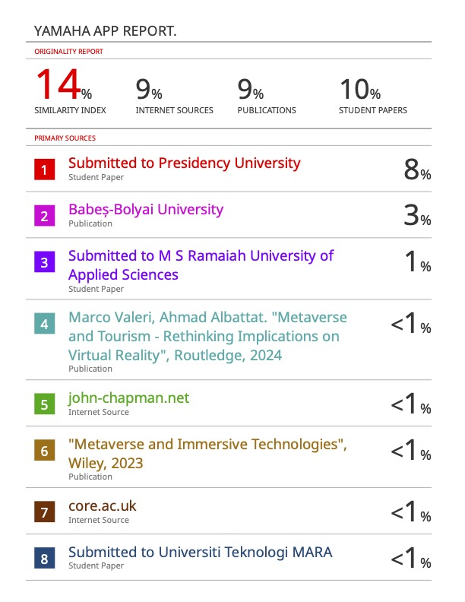
Plagiarism Report

Slide 19
Thank You

